Slide 1

A Look Behind NYC’s Restaurant Grades

Slide 2
In 2010, the Department of Health introduced inspection grades that restaurants were ordered to post in their window.
There are three grades that restaurants can receive as well as a grade pending if they want one more go at getting an A grade.

Slide 3
Graded on a points system:
A : 0-13 points
B: 14-27 points
C: 28 +
Violations include:
Improper food temperatures
Discolored cutting boards
Presence of rodents

Slide 4




The restaurant grading system does not take into account traditional cooking techniques making it harder for ethnic restaurants to get A grades.
The President of the Chinese-American Restaurant
Association, the President of Brooklyn’s Chinese-
American Association and additional restaurant owners have said this.
I wanted to use data to find a way to show the adverse impact the grading system has on ethnic restaurants.

Slide 5
1st Wireframes

Slide 6
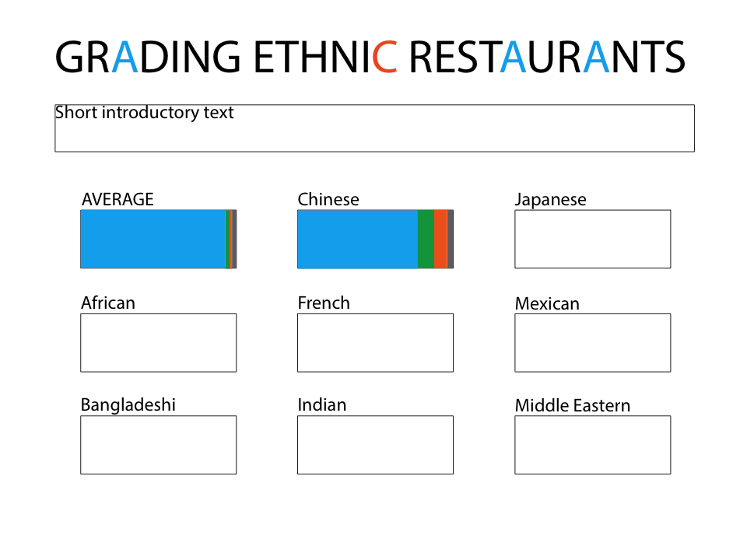

Slide 7


Slide 8
2nd Wireframes

Slide 9


Slide 10



Slide 12
3rd Wireframes (mobile version)

Slide 13


Slide 14


Slide 15


Slide 16


Slide 17
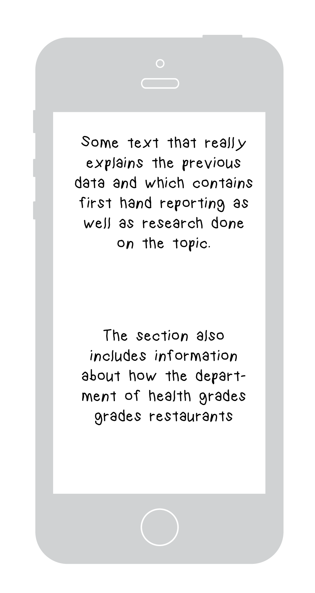

Slide 18


Slide 19
